Slide 1
Mini Project - IronKaggle
Group 2:
Mauricio Dahbar
Khushboo Shrivastava
Gulmehak Dutta
Kira Redberg

Slide 2
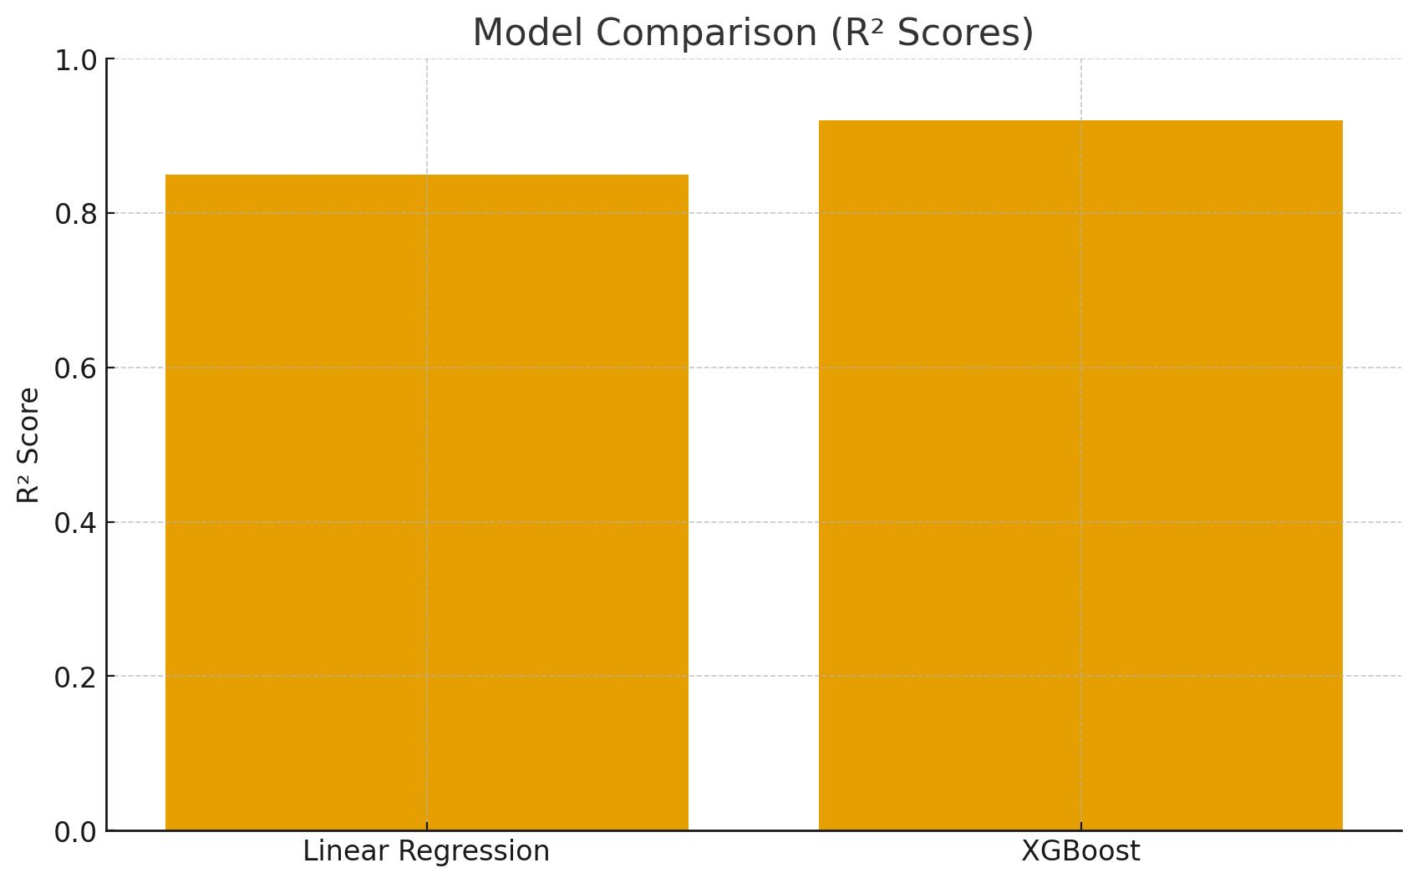
Executive summary
Accuracy with training data:
Model 1: Linear Regression → R² ≈ (~0.8511).
Model 2_: XGBoost → higher R² than Linear Regression. (~0.9396)
Best model: XGBoost performed best (handled non-linearities, no need for scaling).
R² prediction (real-life): Expect moderate generalization, ~0.75 due to complexity and noise in sales data.
Other considerations:
Feature scaling was necessary for Linear Regression but not for XGBoost.
Proper preprocessing (dates, holidays, missing values) strongly affected performance.

Slide 3
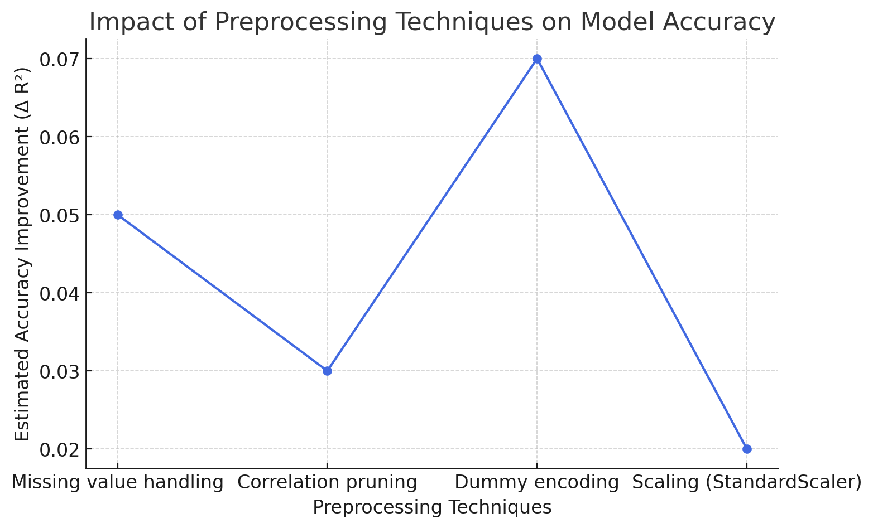
Methods (preprocessing)
Loaded sales.csv into Pandas.
Explored with .head(), .info(), .describe().
Checked missing values → no columns required handling.
Computed correlation matrix + heatmap for feature selection.
Converted categorical features (state_holiday, date) into dummy variables.
Dropped unlabeled data
Scaled numeric features (StandardScaler) for Linear Regression.
Techniques tried:
Correlation pruning.
Scaling (for regression).
Data Split
Discarded: Scaling not needed for XGBoost.
Charts: correlation heatmap, feature inspection, actual/predicted values scatterplot

Slide 4
Methods (models) – 1 or 2 slides
Methods (Models)
Models Tested:
Linear Regression
Simple and interpretable baseline.
Captures linear relationships between sales and features.
Performance: R² ≈ 0.85 on validation data.
Limitation: Struggled with nonlinear dependencies and feature interactions.

Slide 5
Selected model
Chosen: XGBoost Regressor (max_depth=12, learning_rate=0.1, n_estimators=100).
Reason: Best predictive performance and robustness.
Results: Higher R², better generalization on unseen REAL_DATA.csv.

Slide 6
Takeaways
Recap: Tested several models and selected XGBoost for its superior accuracy and stability.
Challenges:
Encoding and aligning categorical variables (state_holiday).
Maintaining consistent preprocessing between training and real datasets.
Preventing data leakage by fitting the scaler only on training data.
Key Learnings:
Proper preprocessing of dates, holidays, and missing values is critical.
Linear Regression serves as a strong baseline but fails to capture complex relationships.
Tree-based models like XGBoost handle nonlinear patterns effectively and achieve higher accuracy in sales prediction.

Slide 7
Instructions
You can make the charts with python or excel.
All team members must participate (either split the slides, or discuss the part that you did for each slide)
7 minutes maximum for presentation + 3 minutes for questions
7 is a HARD limit. Aim for 5, it should be enough.
Tip: Rehearse the presentation at least once

Slide 8
Deliverables
Github repo 🡪 submit to Ironhack
Code
README.md
Presentation (ppt / pdf)
Predictions (G1.csv) 🡨 REAL.csv + column with your sales predictions
Slack
R2 prediction for the REAL dataset

